Slide 1
OSMSR System Test
May 2017
By Shengli

Slide 2
Agenda
…

Slide 3
Overview
Hudson
http://10.151.125.125/hudson/job/OSM_SR_Auto_YYZ/
Build Periodically schedule for every day 18:30
Notes:
<gsepml:ExecuteProvisioningSet
xmlns:sps="http://www.gemalto.com/schema/sps/v1"
xmlns:lpm="http://www.gemalto.com/schema/pm"
xmlns:xsi="http://www.w3.org/2001/XMLSchema-instance"
xsi:schemaLocation=“
http://www.gemalto.com/schema/gsepml/v1 ../gsepml.xsd
http://www.gemalto.com/schema/pm ../pmBatchFile.xsd
http://www.gemalto.com/schema/sps/v1 ../spsBatchFile-v1.0.xsd"
timestamp="2001-12-17T09:30:47Z" version="1.0.0">
<sps:Order transactionId="Trans9911111111“>
<sps:CreateSubscription>
<sps:SubscriptionIdentifier>
<sps:msisdn>0612131313</sps:msisdn>
<sps:iccid>99492011110000000</sps:iccid>
<sps:imsi>00894922220000000</sps:imsi>
</sps:SubscriptionIdentifier>
<sps:elements>
<sps:cardProfile>GXX_v3.2_128K</sps:cardProfile>
<sps:cardAdditionalInfo>4367547687587,84648767765</sps:cardAdditionalInfo>
<sps:subscriptionState>CREATED</sps:subscriptionState>
<sps:ese cud=“564375347654” imei=“76548765998”/>
<sps:smc cplc=“14321543245454”/>
<sps:mobileEquipment imei=“97689654337567” model=“”N309 manufacturer=“”Samsung/>
<!–------- SPS sends this section to SE-KMS --------- ->
<sps:Ota-security>
<![CDATA[
<MBCard serialNumber="99492011110000000">
<SecurityDomain securityDomainID="A000000018434D08090A0B0C000000" defaultSyncID="default" implicitRcAlgoNumber="6" proprietaryRcAlgoNumber="6" >
<Sync value="0000000000"/>
<Keyset versionNumber="1" syncID="Domain1KeySet1">
<Sync value="0000000001"/>
<Kic value="000102030405060708090A0B0C0D0E0F" algoNumber="12"/>
<Kid value="000102030405060708090A0B0C0D0E0F" algoNumber="3"/>
</Keyset>
<Keyset versionNumber="2" syncID="Domain1KeySet2" >
<Sync value="0000000001"/>
<Kic value="000102030405060708090A0B0C0D0E0F" algoNumber="12"/>
<Kid value="000102030405060708090A0B0C0D0E0F" algoNumber="3"/>
</Keyset>
</SecurityDomain>
</MBCard>
]]>
</sps:Ota-security>
<sps:SubscribeTo>
<sps:Capabilities>
<sps:Capability key="Prepaid" value="false"/>
<sps:Capability key="Postpaid" value="true"/>
</sps:Capabilities>
<sps:SubscribedOptions>
<sps:SubscribedOption name="SFR family" state="ACTIVATED"/>
</sps:SubscribedOptions>
</sps:SubscribeTo>
</sps:elements>
<!–------- SPS sends this section to LPM --------- ->
<lpm:CreateSubscription iccid=«99492011110000000» imsi=«00894922220000000» msisdn=«0612131313»
initalState=“ACTIVE” imei=“?” groupId=“?” communicationProtocol=“?” serviceExceutionProtocol=“?” >
<lpm:ExecScript>
public class UpdateHPLMN2
{
public void script ()
{
// variables definitions
short MF = 0x3F00;
short DFGSM = 0x7F20;
short HPLMN = 0x6F31;
// Selection du fichier HPLMN
selectById(MF);
selectById(DFGSM);
selectById(HPLMN);
updateBinary((short)0, new byte[] {(byte)0x0B});
}
}
</lpm:ExecScript>
<lpm:ServiceContent>
<lpm:Portal>
<lpm:Perso label="test" majorVersion="1" minorVersion="0"/>
</lpm:Portal>
</lpm:ServiceContent>
<lpm:Handset>
<lpm:Model manufacturer="LG" name="U300"/>
<lpm:SubscriptionList>
<lpm:Subscription service="EMAIL"></lpm:Subscription>
</lpm:SubscriptionList>
<lpm:ServiceConfigurations>
<lpm:Service type="EMAI" configured="true">
<lpm:GenericParameters name="email_vd2" />
<lpm:UserDependentParameters>
<lpm:characteristic type="APPLICATION">
<lpm:characteristic type="APPADDR">
<lpm:characteristic type="PORT">
<lpm:parm name="PORTNBR« value="587"/>
</lpm:characteristic>
<lpm:parm name="ADDR" value="smtp.mail.yahoo.fr"/>
</lpm:characteristic>
<lpm:characteristic type="APPAUTH">
<lpm:parm name="AAUTHTYPE" value="None"/>
<lpm:parm name="AAUTHNAME" value="benoit"/>
<lpm:parm name="AAUTHSECRET" value="lpm"/>
</lpm:characteristic>
<lpm:parm name="TO-NAPID" value="NAP2"/>
<lpm:parm name="TO-NAPID" value="NAP1"/>
<lpm:parm name="PROVIDER-ID" value="PROVIDER1"/>
<lpm:parm name="NAME" value="ben_gemalto"/>
<lpm:parm name="RT-ADDR" value="ben_gemalto@yahoo.fr"/>
<lpm:parm name="FROM" value="ben_gemalto@yahoo.fr"/>
<lpm:parm name="TO-NAPID" value="NAP3"/>
<lpm:parm name="APPID" value="25"/>
</lpm:characteristic>
</lpm:UserDependentParameters>
</lpm:Service>
</lpm:ServiceConfigurations>
</lpm:Handset>
</lpm:CreateSubscription >
</sps:CreateSubscription>
</sps:Order>
</S:Body>
</S:Envelope>

Slide 4
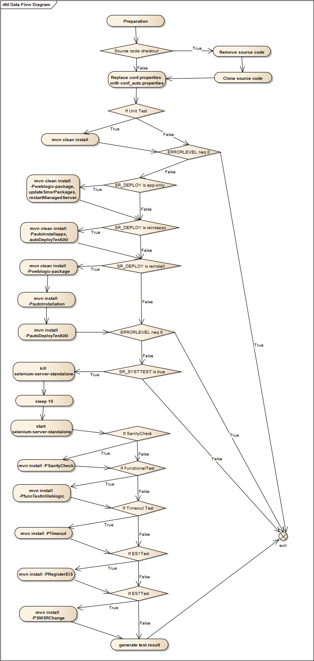
Build Steps

